Slide 1



Final Task Virtual Internship Experience - Adhitya Primandhika
ID/X Partners Data Scientist Virtual Internship Program

Slide 2

Adhitya Primandhika, final year undergraduate student from Information Technology major in Universitas Gadjah Mada with a passion for data science. Proven experience as a Data Engineer Intern, where I developed an API and it’s documentation for hotel performance monitoring website using Python and it’s libraries such as Flask, Flask-RESTX, and Elasticsearch. Skilled in statistical analysis, machine learning, and programming languages such as Python, SQL, and have experience working with big data
technologies like PySpark. Strong ability to communicate technical concepts and lead cross- functional teams to deliver data-driven solutions. Excited to apply my skills and knowledge to new and challenging projects as a data scientist, data analyst or data engineer, and eager to gain more experience in the industry.
Adhitya Primandhika

Slide 3
Contents
Discussion in this presentation
01
Understanding Data
02
Data Pre-
processing
03
Create ML Model
04
Evaluation & Saving Model

Slide 4
01
Understanding Data

Slide 5
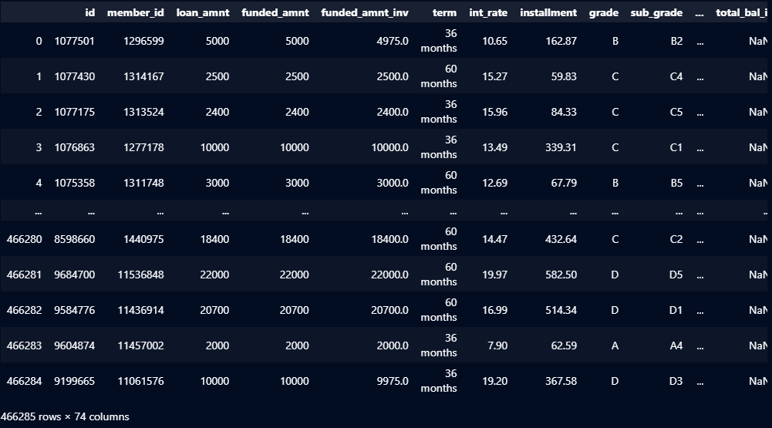
Understanding Data
Before we create ML model we need to understand our data
This dataset has 74 column and 466285 data. By using this dataset, we are asked to build a model that can predict credit risk using a dataset provided by the company which consists of data on loans received and rejected.

Slide 6
02
Data Pre-Processing

Slide 7
Data Pre-Processing
After understanding our data, we need to prepare our data
We will prepare our data by doing data pre-processing. In this part, we will do some tasks, that is:
Dropping unnecessary columns
Handling null values
Assigning target column
Transforming data to numerical.

Slide 8
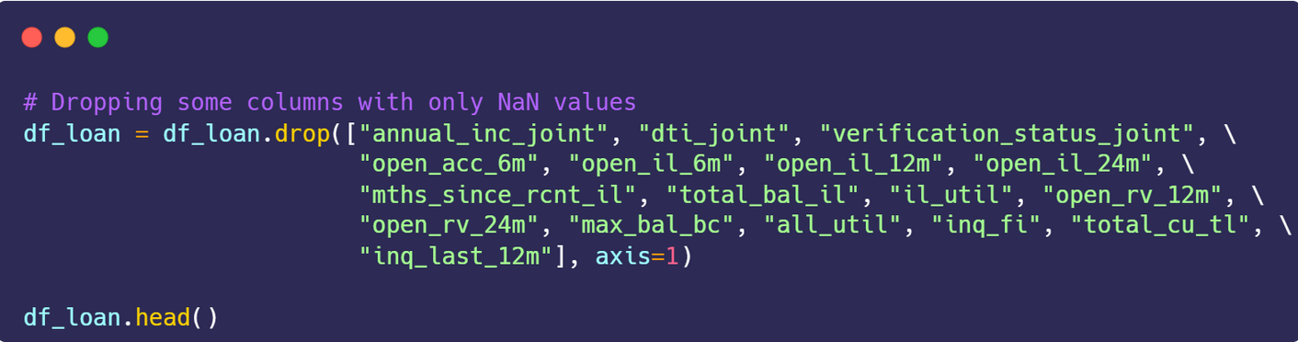
Data Pre-Processing
Dropping columns with NaN values
We will drop some columns with NaN values only. There are "annual_inc_joint", "dti_joint", "verification_status_joint", "open_acc_6m", "open_il_6m", "open_il_12m", "open_il_24m", "mths_since_rcnt_il", "total_bal_il", "il_util", "open_rv_12m", "open_rv_24m", "max_bal_bc", "all_util", "inq_fi", "total_cu_tl", and "inq_last_12m"

Slide 9
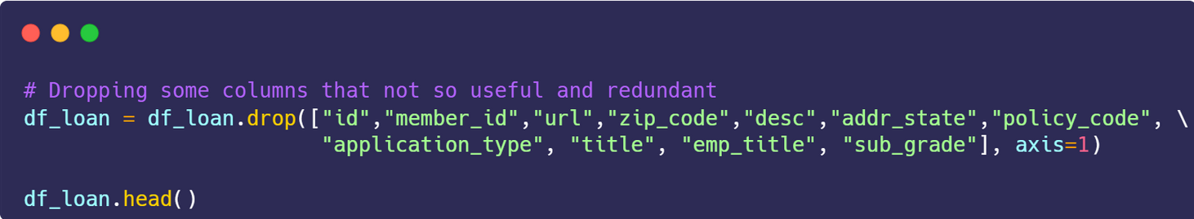
Data Pre-Processing
Dropping columns that not so useful and redundant
We will drop some columns that are not useful for our machine learning modelling later such as id, member_id, some columns like desc that the value already represented by purpose column, and also some columns that only have 1 unique value.

Slide 10
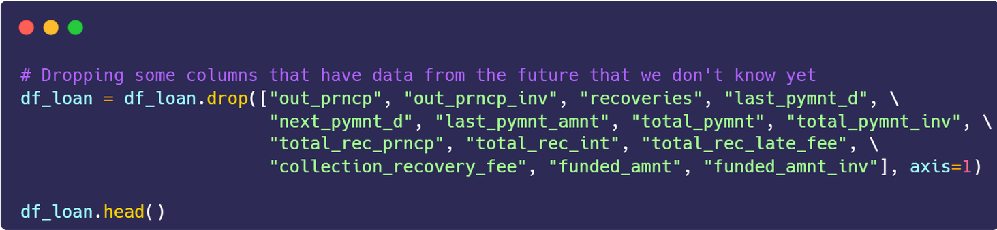
Data Pre-Processing
Dropping columns that have data from the future that we don't know yet
We also need to drop some columns that have data from the future. Because we want to create model that can predict is it the good loan or a bad loan based on data before the credit is given.

Slide 11
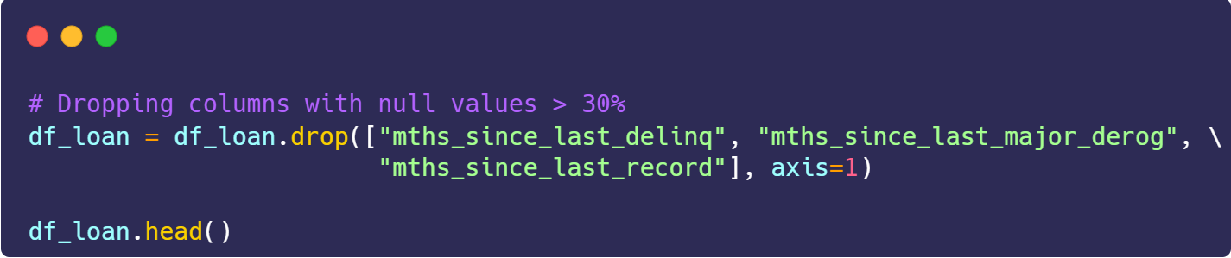
Data Pre-Processing
Dropping columns with null values > 30%
We also need to drop some columns that have null values more than 30 %. This need to do for making our model better.

Slide 12
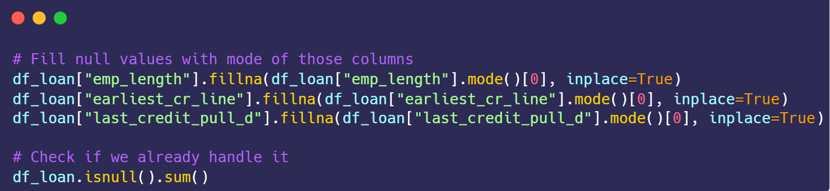
Data Pre-Processing
Handling null values for non-numerical columns
We can handling the non-numerical columns by filling the null values with mode of each column.

Slide 13
Data Pre-Processing
Handling null values for numerical columns
We can handling the numerical columns by filling the null values with mean or median. But in this occasion, we will see the distribution of each column first.

Slide 14
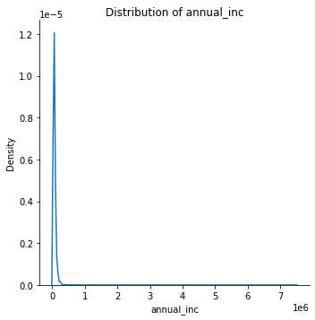
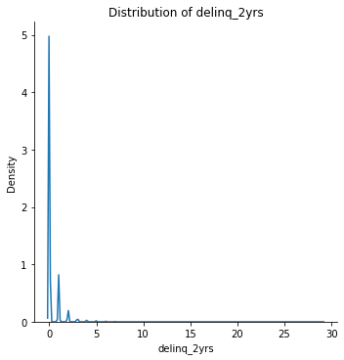
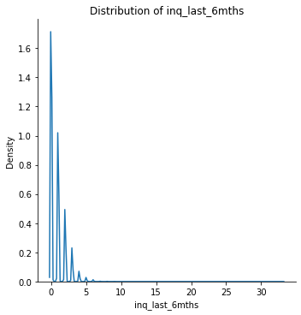
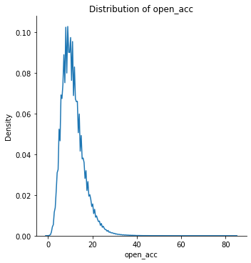
Data Pre-Processing
Handling null values for numerical columns

Slide 15
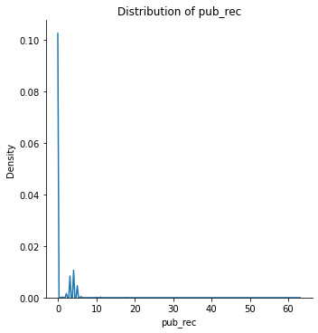
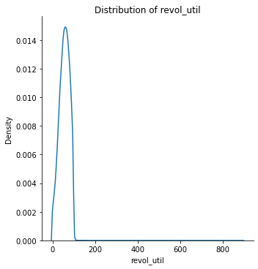
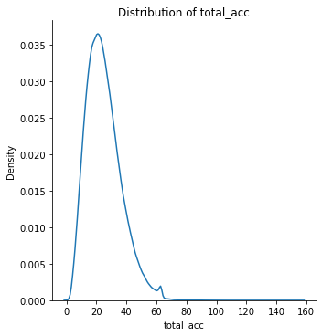
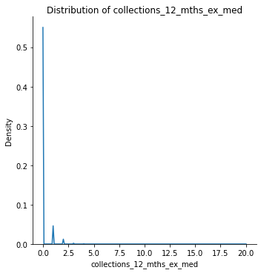
Data Pre-Processing
Handling null values for numerical columns

Slide 16
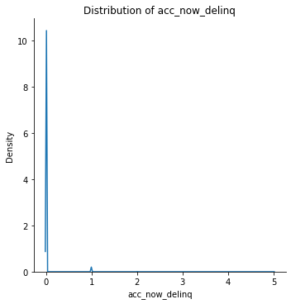
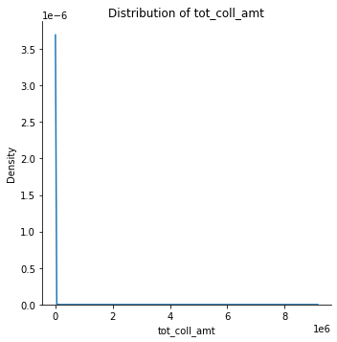
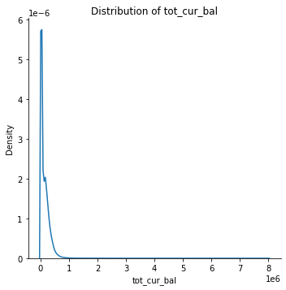
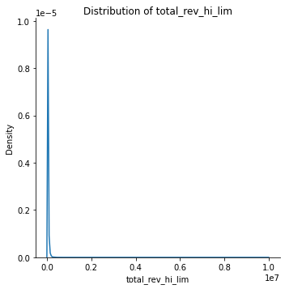
Data Pre-Processing
Handling null values for numerical columns

Slide 17
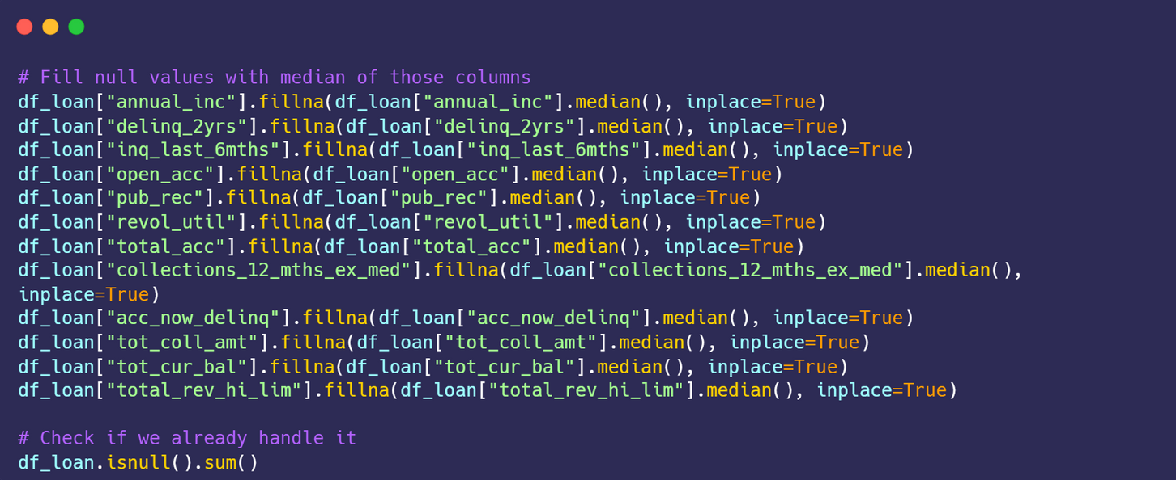
Data Pre-Processing
Handling null values for numerical columns
Since all distributions
of the from each
columns is skewed, so we can handle the null values by fill the null values by the median of the data.

Slide 18
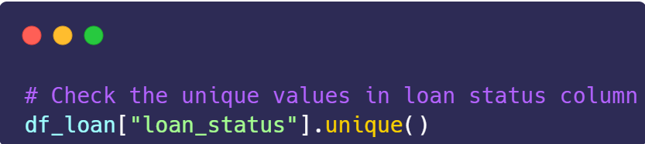
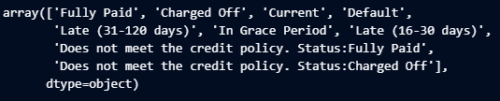
Data Pre-Processing
Assign new column as target column
First
thing
first we unique column
need to value of
check the loan_status
to makle
new target column.

Slide 19
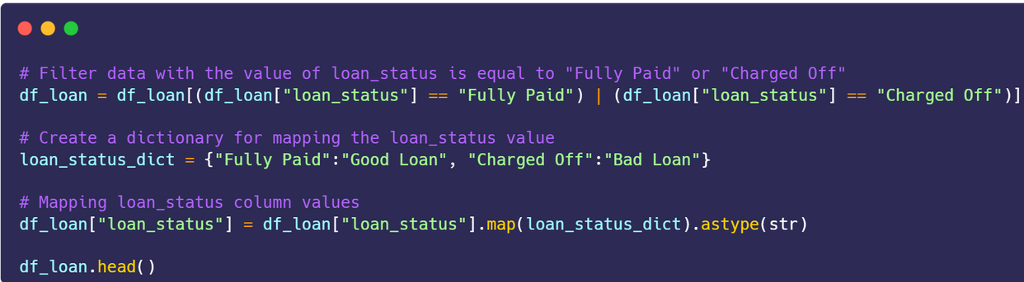
Data Pre-Processing
Assign new column as target column
Since we only want to know whether it will be a good loan or a bad loan, so we can filter data with values only "Fully Paid" or "Charge Off". Its because those values show the difference while another values are from the future and also not described well. Then we will map the value of loan_status into "Good Loan" and "Bad Loan".

Slide 20
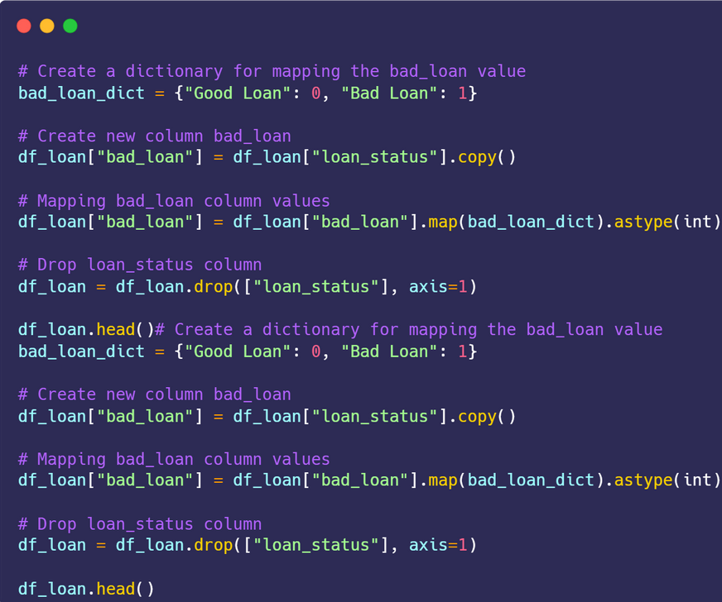
Data Pre-Processing
Assign new column as target column
Next, we create new column bad_loan and mapping into "Good Loan":0 and "Bad Loan":1. Then we drop loan_status column.

Slide 21
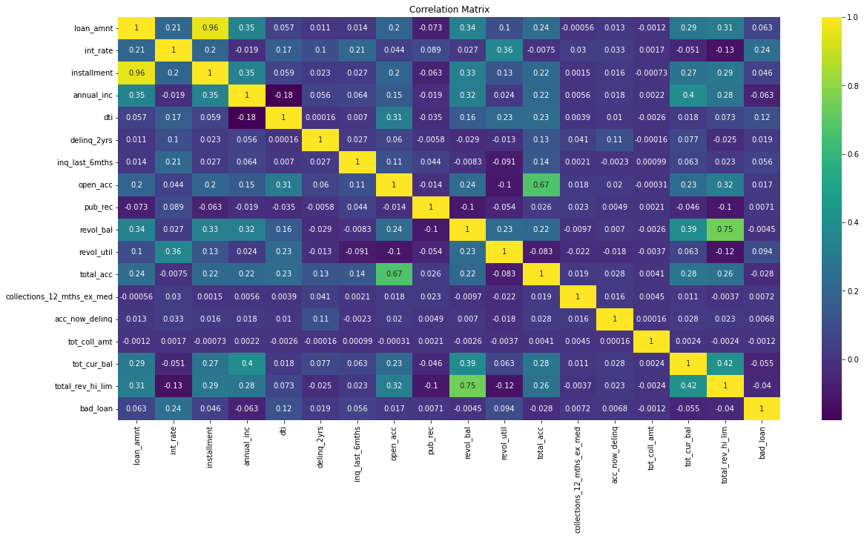
Data Pre-Processing
Check correlation
From the correlation matrix above, we can see the highest correlation with our target column is int_rate. It shows that the bigger value of the interest rate of the loan, the biggest chances that show it is a bad loan.

Slide 22
Data Pre-Processing
Transform data into numerical
There are 11 column that we need to transform into numerical.

Slide 23
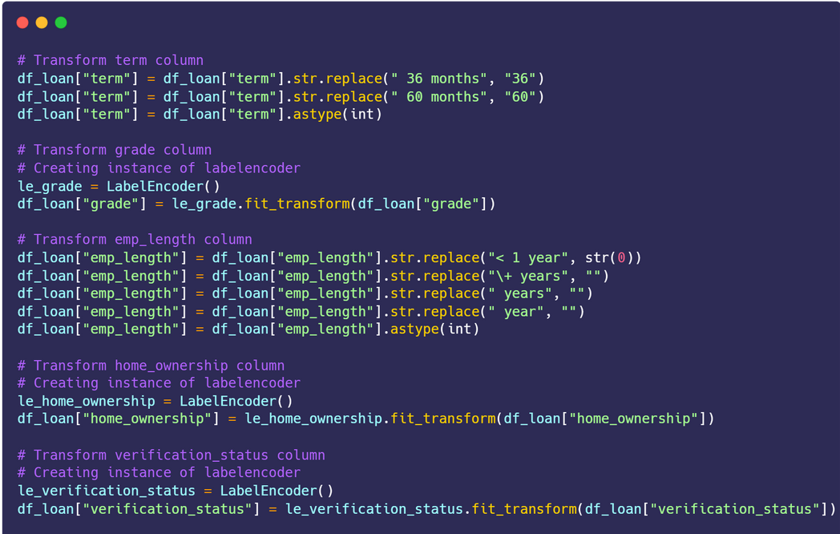
Data Pre-Processing
Transform data into numerical

Slide 24
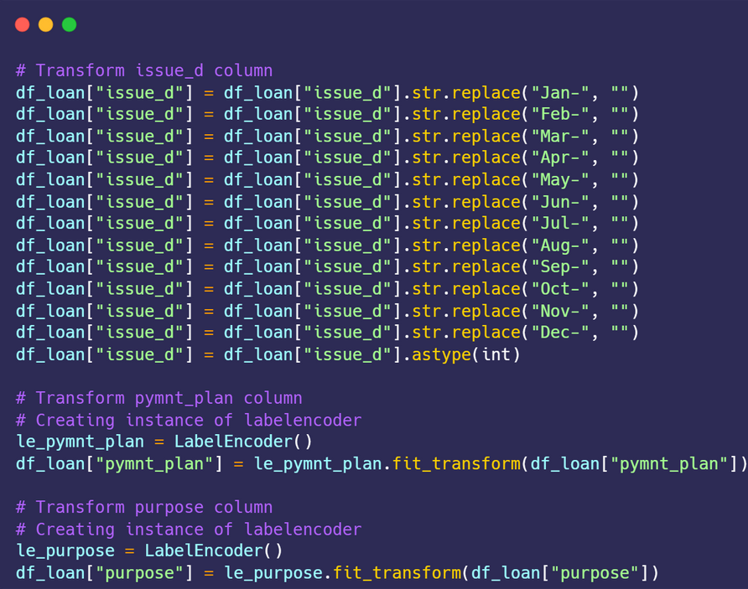
Data Pre-Processing
Transform data into numerical

Slide 25
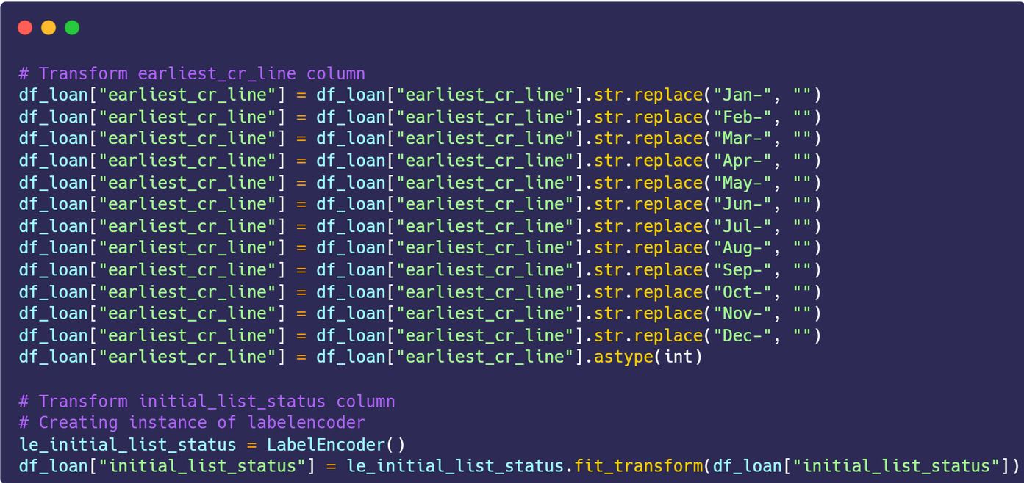
Data Pre-Processing
Transform data into numerical

Slide 26
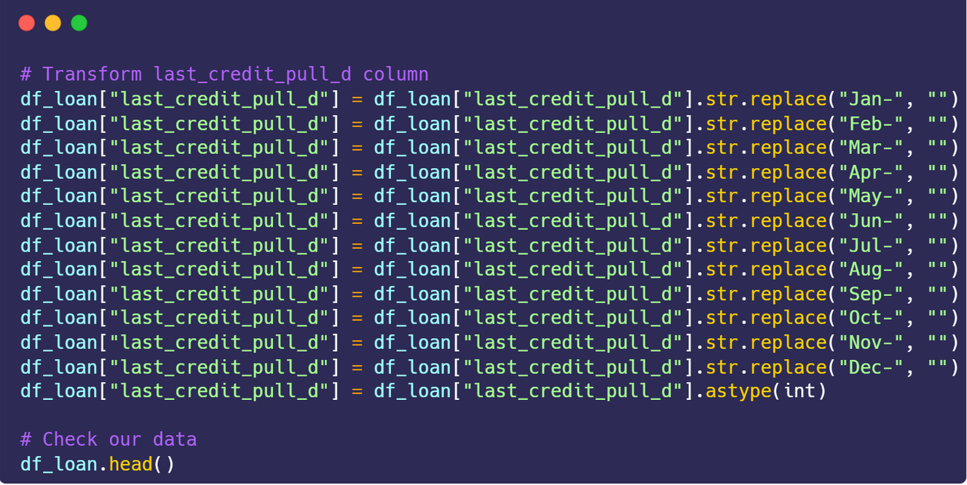
Data Pre-Processing
Transform data into numerical

Slide 27
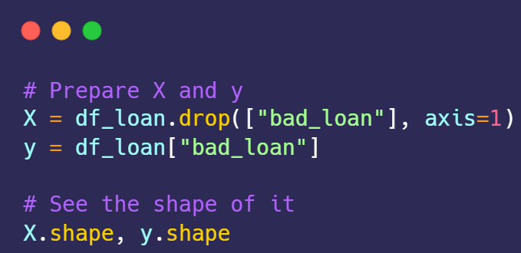
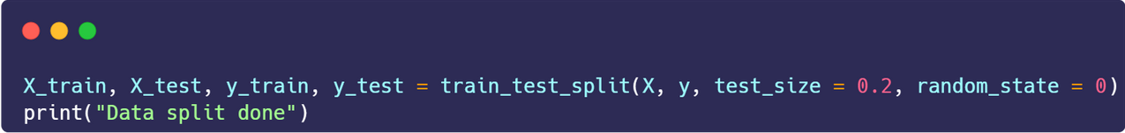
Data Pre-Processing
Preparing data into X (features) and y (target)
We will create X and y where X is our features and y as our target column. In this problem, our target is bad_loan column.

Slide 28
Create ML Model
03

Slide 29
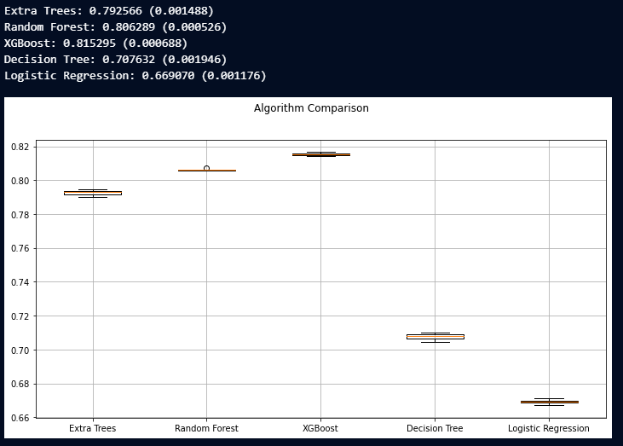
Create ML Model
Select the best model
Next we compare some algorithm to used as our model. There are Extra Trees, Random Forest, XGBoost, Decision Tree, and Logistic Regression. From the comparison, we got that XGBoost algorithm has the best accuracy among others. So, we
will use XGBoost as our model.

Slide 30
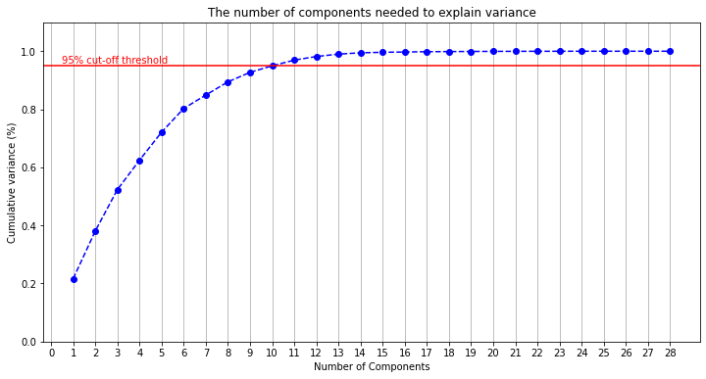
Create ML Model
PCA (Principal Component Analysis
Besides using XGBoost as our model, to improve the performance of our model we also use PCA to do dimensionality reduction. First
thing we do is choosing components create by PCA.
the right We want the
total the
explained variance from
principal
components of PCA is 95%. So, by testing it we got 10 for our number of components from our PCA. We can see them on graph.

Slide 31
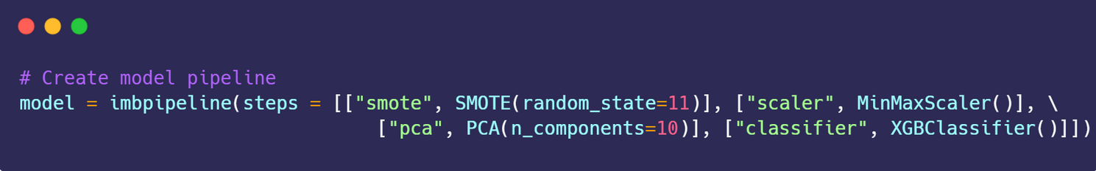
Create ML Model
Create Pipeline
Next, we will create our model pipeline. In this pipeline, we will use SMOTE to handling imbalanced in our data, normalization to make our data more normalize, PCA to do dimensionality reduction, and XGBoost classifier as our classifier.

Slide 32
03
Evaluation & Saving Model

Slide 33
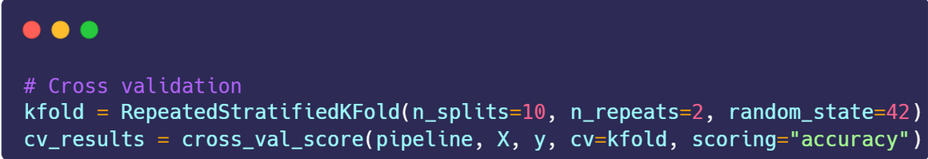
Evaluation & Saving Model
Evaluation
Next, we will do evaluation using cross validation. For the configuration , we can see on the code below.
From our model we got accuracy 0.82 or 82% which is quite good but can be improve for the next iteration,

Slide 34
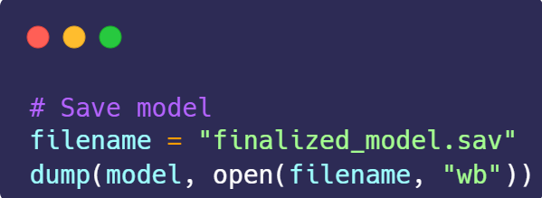
Evaluation & Saving Model
Save Model
Last but not least, we save our model so we can use it again next time.

Slide 35
Thank you for your time!
Email me if you're interest with this works @adhityaprimandhika@gmail.com

